Slide 1
Strategic Management Project
Strategic Business Plan for Starbucks Coffee Shop

Slide 2
Executive Summary
Starbucks Coffee Shop in Moore Oklahoma is designed to be one of the most promising corporations in the United States
The chief product offered will be coffee (Field, 2018).
The Starbucks Coffee Shop will operate under strict guidelines and monitoring by the Starbucks Corporation
The new brand will integrate a variety of models used applied in the Starbucks corporation
The Starbucks coffee shop will use varied primary marketing strategies
Qualified managers will be hired to oversee the employee in the new coffee shop
The total investment of launching the Company is projected as $1015000 (Field, 2018)
The breakeven point will be met by the mid of the second financial year
Notes:
Starbucks Coffee Shop in Moore Oklahoma is designed to be one of the most promising corporations in the United States. Strategic business plan for Starbucks coffee shop is aimed at benefiting the attributed brand popularity and acceptance of the Starbucks products across the globe. The chief product offered will be toasted coffee (Field, 2018). The Starbucks Coffee Shop will operate under strict guidelines and monitoring by the Starbucks Corporation. More importantly, the new brand will integrate a variety of models used applied in the Starbucks corporation. The Starbucks coffee shop will use brand quality, consumer experience, segmentation, store location, premium pricing, and ethical sourcing as the primary marketing strategies. Qualified managers will be hired to oversee the employee in the new coffee shop. The total investment of launching the Company is projected at $1015000. The new brand will be expected to attain breakeven point by the mid of the second financial year. Starbucks coffee shop investors have agreed to make repayment of the financial debt to the banking institution before sharing any profit.

Slide 3
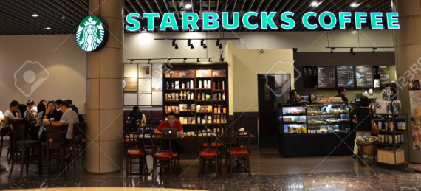
Strategic Focus
The aim of this business plan is to establish a Starbucks Coffee Shop licensed by the Starbucks Corporation
The mission of the Company is to provide all customers with the unparalleled value of their money in daily purchases; quality coffee beans, more specialist coffee roasters, and most exceptional beverages than the competitors
Starbucks Coffee Shop focuses on creating a positive reputation among consumers in the coffee and beverage industry in the U.S. and the world in general (Kim, 2015)
Notes:
This business plan aims to establish a Starbucks Coffee Shop licensed by the Starbucks Corporation. The mission of the Company is to provide all customers with the unparalleled value of their money in daily purchases; quality coffee beans, more specialist coffee roasters, and most exceptional beverages than the competitors. Starbucks Coffee Shop focuses on creating a positive reputation among consumers in the coffee and beverage industry in the U.S. and the world in general (Kim, 2015).

Slide 4

Continuation of strategic focus
Company goals:
The Starbucks coffee company seeks to:
Have the largest market share in Oklahoma.
Document its advancement and work closely with marketing crews to meet the set goals throughout the year.
Endeavor in sourcing the best qualities to attract many consumers.
Achieve the goal through product differentiation and offering unmatched prices in the industry.
Invest in market research to understand consumer needs.
Achieve a vast consumer base in the second year after inception.
Notes:
The Starbucks coffee shop seeks to access the largest market share in Oklahoma. It aims to document its advancement and work closely with marketing crews to meet the set goals throughout the year. Another goal is to make an effort in sourcing the best qualities to attract many consumers. Starbucks coffee shop is also committed to the target through product differentiation and offering unmatched prices in the industry. Starbucks will also make efforts to invest strongly in market research to understand consumer needs while achieving a vast consumer base in the second year after inception.

Slide 5
Continuation of strategic focus
Performance Area | Performance Measures | Target | Time Frame
Financial Performance | Be the leading seller in Moore, Oklahoma | Attain revenue of $821,250 | First Fiscal year
Customer and Market Performance | Improve customer loyalty in the region. Claim a larger market share in the region |  | From day 1 of foundation
Internal Efficiency and Effectiveness | Sensitivity in hiring workers. | To become the leading company in providing unmatched consumer experience | From day 1 of foundation
Long Term Development and Innovation | Open other licensed coffee outlets | To measure the performance processes for every six months | In third fiscal year after inception

Slide 6
The Business
Company overview:
The new Starbucks Company will have only four significant stakeholders
The primary rationale of franchising the Company is to operate independently, but at the same time, enjoy the popularity of Starbucks brands
The Company strives to take advantage of the rising consumption of coffee in the United States (Kim, 2015)
The Company will be located in Moore, Oklahoma
The Company will first operate on a national level to establish itself but will expand globally in the future after agreements with the parent brand
Notes:
From a general overview of the Company, the new Starbucks Company will have only four significant stakeholders who will be the highest bidders and sponsors to the newly established brand. The company operations will depend on franchising to operate independently, but at the same time, enjoy the popularity of Starbucks brands. The Company strives to take advantage of the rising consumption of coffee in the United States (Kim, 2015). Strategic location is also a paramount element of strategic planning. Herein, the new Starbucks coffee shop will be located in Moore, Oklahoma. Also, the Company will first operate on a national level to establish itself but will expand globally in the future after agreements with the parent brand

Slide 7
Continuation of the Business
The Company will provide in-service training for its employees
The main advisors will be solicitors who will enable the Company to establish itself and enforce its values under a different ownership brand
The Company will hire different consultants to help understand the market and fulfill the set goals (Field, 2018)
The Starbucks coffee shop’s critical competitive advantage is based on the popularity and acceptability of the mother brand, Starbucks Corporation
The estimated brand weakness is on the fact that product differentiation will lose the credibility of the brand since the parent brand is already known in the market
Notes:
To ensure improve and quality service provisions, the Company will provide in-service training for its employees. The Company’s smooth operation will be based on the efforts of solicitors; advisors who will enable the Company to establish itself and enforce its values under a different ownership brand. Also, the Company will hire various consultants to help understand the market and fulfill the set goals. The Starbucks coffee shop’s critical competitive advantage is based on the popularity and acceptability of the mother brand, Starbucks Corporation. The estimated brand weakness is on the fact that product differentiation will lose the credibility of the brand since the parent brand is already known in the market. The management will be required to give a lot of emphasizing on the outlined operational goals for improved performance.

Slide 8
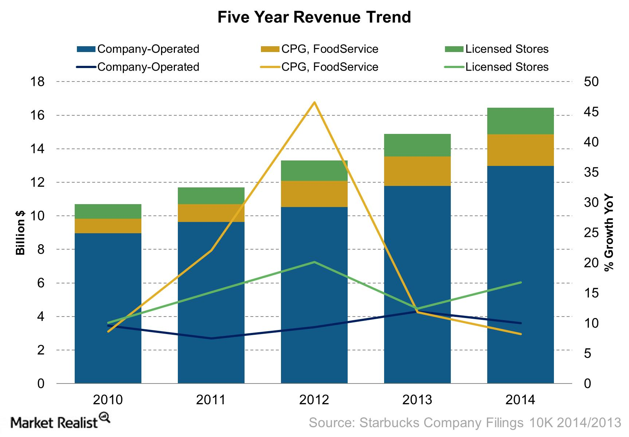
Market Analysis
The coffee shop industry in the U.S. accounted to $45.4 billion for the last fiscal year
The market growth of coffee shop is expected to grow more in the coming years as coffee consumption increases in the country.
The industry is likely to experience stiff competition among other rapid changes
Consumer demand for experiences The coffee shop industry has grown very competitive
The Starbucks coffee shop must provide more quality brands to maintain and attract more consumers and enhance retention
Notes:
Every competitive industry has strongly bound features, and hence, the coffee shop industry is not exceptional. The coffee shop industry in the U.S. has had a positive transition, accounting to $45.4 billion for the last fiscal year. The market growth of coffee shop is expected to grow more in the coming years as coffee consumption increases in the country.
Moreover, the industry is likely to experience stiff competition among other rapid changes. It should be noted that consumer demand for experiences and premium products are depended on the quality of service they get, and hence, they will serve as the driving forces of the coffee shop supply chains. The coffee shop industry has grown very much competitive. However, the Starbucks coffee shop must provide more quality brands to maintain and attract more consumers and enhance retention to achieve success.

Slide 9
Products
Starbucks Coffee Shop production will be based on current technology
The management will embrace high standards and ensuring the impressive consumer experience
Starbucks Coffee Shop will provide a seasonal offering to meet season based customer demands (Field, 2018)
Starbucks Coffee Shop will ensure that all the employees are regularly involved and conscious of the overall objectives and the Company’s mission
The competitive advantage of the company product is that the products have been tested and highly accepted in the market
The Company has complied with the robust rules in the food and drug industry
Notes:
The Starbucks Coffee shop strives to offer the most promising Coffee Shop production based on current technology. The management will embrace high standards and ensuring impressive consumer experience while focusing on customer retention. More importantly, Starbucks Coffee Shop strategizes for seasonal offering to meet season based customer demands in the entire industry. The Coffee Shop will ensure that all the employees are regularly involved and conscious of the overall objectives and the Company’s mission. The competitive advantage of the company product is that the products have been tested and highly accepted in the market. Also, product differentiation will be highly emphasized to allow acute brand establishment and stabilization. The Company has also complied with the robust rules in the food and drug industry to ensure effective adherence to codes of operations.

Slide 10
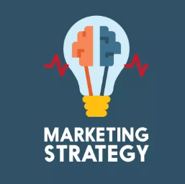
Marketing
Starbucks Coffee Shop seeks to reach a nationwide network of people who are passionate about quality coffee products
Starbucks Coffee Shop marketing strategies are based on:
  Brand quality
  Positioning, segmentation
  Ethical products promotions and advertising
  Social media advertising
Notes:
Starbucks Coffee Shop seeks to reach a nationwide network of people who are passionate about quality coffee products. The brand quality which will help in improving the brand image as well as reputation in addition to immense quality and taste for higher popularity and recognition in the food sector. Strategic market positioning will help the Starbucks coffee shop to become among the most beautiful coffee brands founded on an overall coffee experience to its customers. In regard to market segmentation, Starbucks Coffee shop will target people who want a peaceful environment to take coffee and drive the fatigue away and depending on demographics and levels of income.
Ethical products promotions and advertising will be highly focused on ensuring that the advertising team uses highly promising language which can win and retain customer’s attention towards consuming the Starbucks coffee shop products. The Starbucks Company model will intensely advertise in televisions and other media outlets. As a result, the Company will be in a position to advertise the newest products and products available in the stores
Social media advertising is another strategic move for the Company’s marketing plan. Different social media platforms will be applied to suitably educate and inform consumers on the effects of the consumer company. Notably, effective marketing strategies will play a big role in brand awareness and reputation.

Slide 11
Research and Development
Research and development will majorly rely on cultural trends, gathering consumer feedbacks, in-store product testing, and monitoring responses from social media
Starbucks Idea platform will be used as a basis for research and development
The suggested idea platform will help in nurturing customer’s loyalty through:
  Ensuring consumers suggestions are integrated with developing the products.
  Integrated social listening in the development of the products.
  Acute inspection and monitoring digital platforms that collects all the responses of the consumer acceptance of the brand and use the information in improving the brand (Kim, 2015).
  Testing new products to figure out any change that would be required before launching the product.
  Integration of research findings gleaned from approved research firms in the food sector
Notes:
Research and development will majorly rely on cultural trends, gathering consumer feedbacks, in-store product testing, and monitoring responses from social media. Starbucks Idea platform will be used as a basis for research and development. The suggested idea platform will help in nurturing customer’s loyalty through ensuring consumers suggestions are integrated with developing the products, and integrated social listening in the development of the products. It will also help in acute inspection and monitoring digital platforms that collects all the responses of the consumer acceptance of the brand and use the information in improving the brand (Kim, 2015). The suggested idea platform will also enhance testing new products to figure out any change that would be required before launching the product and acute integration of research findings gleaned from approved research firms in the food sector

Slide 12
Continuation of R&D
Intellectual Property Protection:
Starbucks Coffee shop will register its brands to march the parent Starbucks Company trademarks to ensure infringement protection
To prevent parody businesses from marketing their products under Starbucks name as provided by the fair use laws
Starbucks Coffee shop will employ app-based ordering as well as mobile payments
Currently planned R&D activities include the adoption of food products based on time of the day or order history
The Company will continue investing in market research and integrate concrete and adaptable practices that will enable the Company to remain competitive in the coffee sector (Suasana, 2016)
Notes:
Starbucks coffee shop pays attention to intellectual and operation practices to enhance corporation success. In this regard, the Starbucks Coffee Shop will register its brands to march the parent Starbucks Company trademarks to ensure infringement protection. In addition, the I.P. litigation will be a core precarious move to prevent parody businesses from marketing their products under Starbucks name as provided by the fair use laws. The Starbucks Coffee shop will employ app-based ordering as well as mobile payments; a significant step towards intellectual based service delivery. Currently planned R&D activities include the adoption of food products based on time of the day or order history. The Company will continue investing in market research and integrate concrete and adaptable practices that will enable the Company to remain competitive in the coffee sector (Suasana, 2016).

Slide 13
Production and Delivery
Customer experience in every firm starts at production
The production will be done at the plant location in Moore, Oklahoma
The Company will focus on offering a vast array of products is produced
Production and supply chain management team will ensure the acute flowing of products to the consumers
The Company will hire a committed team of professionals for packing, blending, grading, and a storage mechanism
Quick delivery of the products to the customers will be emphasized through the integration of digital platforms
Innovative transformations will be encouraged for the projected internet
The adopted delivery mode will influence the customer experience as well as the business itself
Notes:
Starbucks coffee shop will be ambitious to record reputable production and delivery of its products. In this setting, customer experience in every firm starts at production, and hence the production will be done at the plant location in Moore, Oklahoma. The Company will focus on offering a vast array of products is produced. Production and supply chain management team will ensure the acute flowing of products to the consumers in a reliable and timely manner. The Company will hire a committed team of professionals for packing, blending, grading, and storage mechanisms to enhance supply. Quick delivery of the products to the customers will be emphasized through the integration of digital platforms. Innovative transformations will be encouraged for the projected internet. Also, the adopted delivery mode will influence the customer experience as well as the business itself.

Slide 14
Supply Chains
Supply chain in Starbucks Company ensures that a customer gets a quality cup of coffee
The process starts with sourcing the best qualities of coffee beans
The supply chain will be challenged by stiff competition in the industry
The supply chain of the Company entails:
  Plan
  Source
  Make
  Deliver
Notes:
Supply chain in Starbucks Company ensures that a customer gets a quality cup of coffee. The process starts with sourcing the best qualities of coffee beans, which are either locally manufactured or imported (Kim, 2015). In addition, the supply chain of the Company is broken into four core functions, which include plan, source, make, and deliver. This is made possible by the standards set by the Company. The supply chain will be challenged by stiff competition in the industry.

Slide 15
Continuation of Supply Chain
The Standards
Starbucks Corporation has adopted a vertical supply chain
Starbucks staff works directly with coffee growers across the globe to ensure quality raw coffee beans as well as maintaining the quality flavor
The Company seeks to provide ethically sourced, Fair Trade Coffee
Starbucks has formulated its own coffee and Farmer Equity (C.A.F.E.) standards as well as Coffee sourcing guidelines (C.S.G.)
The Company has formulated a stringent vetting process force farmers to meet and adhere to the set standards
Starbucks ensures that the suppliers undergo special education and training programs.
Notes:
Standards are highly underscored in the Company for increased brand reputation and customer loyalty. As evident, the Starbucks Corporation has adopted a vertical supply chain, and so Starbucks coffee shop is not exceptional. Starbucks staff works directly with coffee growers across the globe to ensure quality raw coffee beans as well as maintaining the quality flavor. The Company seeks to provide ethically sourced, Fair Trade Coffee. Starbucks has formulated its own coffee and Farmer Equity (C.A.F.E.) standards as well as Coffee sourcing guidelines (C.S.G.). The Company has formulated a stringent vetting process force farmers to meet and adhere to the set standards. Starbucks ensures that the suppliers undergo special education and training programs in an effort to reduce the major disruptions such as shortages and to overplant

Slide 16
Continuation of supply chain
The Processes
The coffee growers pick and package the beans
The unroasted beans are transported to the Company’s storage facilities (Suasana, 2016)
The coffee beans are roasted in the storage facilities and then shipped to distribution centers
The Company uses digital technology aided by other small tools and processes to manage the overall supply chain.
This helps the Company to adjust its process instantly.
The well-coordinated supply chain ensures a high level of agility and efficiency
The future of the Company lays on the consistency of efficiency of the supply chains
Notes:
The process of supply in the industry encompasses a series of activities. As such, the coffee growers pick and package the beans. The unroasted beans are transported to the Company’s storage facilities where they are roasted and then shipped to distribution centers. The Company uses digital technology assisted by other small tools and processes to manage the overall supply chain (Suasana, 2016). Such a practice helps the Company to adjust its process. Overall, the well-coordinated supply chain ensures a high level of alertness and efficiency of the supply chains.

Slide 17
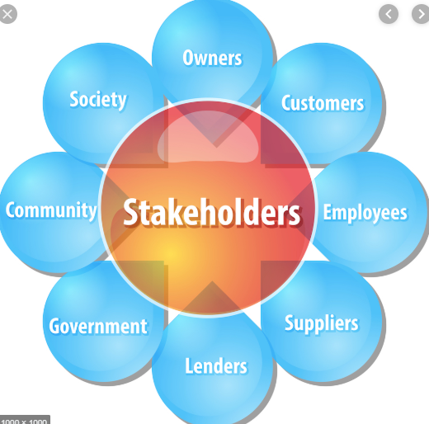
Stakeholder Relationships and Alliances
Starbucks Coffee Shop stakeholders include:
Employees
Customers
Suppliers
Government
Investors
The environment
Notes:
The Company gives a lot of emphasis on the wellness of employees. The Company underscores on job security, appropriate wages, and safe working environment. The management has been committed to polish on just and fair treatment of all employees
Customers are viewed as the greatest stakeholders in the Company. Starbucks successfully addresses consumer interests. There exists apparent linkage amid Company and customers in the extended coffee café shops in different locations across the globe. Starbucks Coffee shops strive to meet all the interests of the customers
Starbucks suppliers include coffee growers and wholesale supply firms. Investors are clear, high financial performance of a business
Government is another essential stakeholder of the Company. The Company must conform to various government interests as integral stakeholders in the coffee sector, Starbucks has created a good reputation in complying with legal laws and regulations
Investors are clear, the high financial performance of a business. Starbucks growth both at the national and international level as well as continued dominance in the coffee sector is a direct indication of excellent financial performance. Starbucks performance has reclaimed its dominance, and the growth curve is even expected to get better in the future (Kim, 2015)
The environment is a core element of emphasis for the Starbuck coffee shop. The CAFE program has deeply encouraged biodiversity. The Company pays a lot of attention in addressing the environmental issue

Slide 18
Organizational and Management
The Starbucks Coffee shops are controlled by BOD
A store manager serves as the boss who oversees the staff at a store location.
The licensed stores are owned by individuals but are controlled by the corporation under a strict guideline (Sammogia, 2019).
The overall Starbucks staff encourages teamwork
The corporations’ management is apparent in ten distinct areas
Starbucks’ staff works together as a team in an effort to provide quality products, exceptional customer service, and satisfaction
Notes:
The Starbucks Coffee shops are controlled by the Board of Directors. Store manager serves as the boss who oversees the staff at a store location. The licensed stores are owned by individuals but are controlled by the corporation under a strict guideline. The overall Starbucks’ staff works together as a team in an effort to provide quality products, exceptional customer service, and satisfaction (Sammogia, 2019). The corporations’ management is apparent in ten distinct areas, and thee includes the design of goods and services, quality management, process and capacity design, situational strategy, layout design and strategy, job design and human resources, supply chain management, inventory management, scheduling, and maintenance.

Slide 19
Environmental and Social Impacts
Starbucks’ community social responsibilities underscore on the environment, ethical sourcing, and community (Spring, 2014)
The Company ensures high ethical standards during the production process
Starbucks considers the environment as an integral element in the business
Different strategies to improve the wellbeing of communities through CSR
Notes:
Starbucks’ community social responsibilities underscore on the environment, ethical sourcing, and community. The Company ensures high ethical standards during the production process by ensuring that the most recommended measures are applied in the entire reproduction process (Spring, 2014). Moreover, Starbucks considers the environment as an integral element in the business and hence it has adopted different strategies to improve the wellbeing of communities

Slide 20
Risk Factors and Regulatory Compliance
Potential risk factors threatening the industry include:
Competition
Economic downtown and changes in the pricing model
Declining retail traffic poses spillover effects
The increasing international expansion could prove to be a threat to Starbucks
Starbucks compliance with regulations is strongly emphasized in the business missions
Corporate Governance
The Company has a well-outlined structure of corporate governance
The Board of Directors consists of nine members who meet the requirements defined by N.A.S.D.A.
The Company is headed by a C.E.O.
The Company has formulated clear guidelines in the selection of new directors
The key guidelines defined the boundaries for the ethical foundation
The shareholders and partners provide their suggestions and views.
Notes:
Starbucks Coffee shop is likely to encounter varied risky factors such as stiff competition in the coffee shop industry. Other challenging issues include economic downtown and changes in the pricing model, declining retail traffic poses spillover effects, increasing international expansion could prove to be a threat to Starbucks, and the difficulties in compliance with regulations is strongly emphasized in the business missions.
In regard to corporate governance , the Company has a well-outlined structure of corporate governance which includes the Board of Directors consists of nine members who meet the requirements defined by N.A.S.D.A. The Company is headed by a C.E.O. The Company has formulated clear guidelines in the selection of new directors. The management has also vised key guidelines which define the boundaries for the ethical foundation. In addition, the shareholders and partners provide their suggestions and views as a means of giving reputable contribution in addressing business oriented governance.

Slide 21
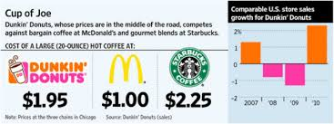
Financials
The average total costs of opening a Starbucks licensed coffee shop is approximately $315000
The Company expects the owner of a new outlet to have liquid assets of over $700000
The total capital expected to start the capital is approximately $1015000 (Morais, 2014)
The crucial determinants of the profitability are the variable costs and the fixed costs
Fixed financial expenses for the Company are insurance, taxes advertising and rent
Notes:
The average total costs of opening a Starbucks licensed coffee shop is approximately $315000. The Company expects the owner of a new outlet to have liquid assets of over $700000. The total capital expected to start the capital is approximately $1015000. The crucial determinants of the profitability are the variable costs and the fixed costs. Fixed financial expenses for the Company are insurance, taxes advertising and rent.

Slide 22
Application of Investment funds
The capital structure of launching the Starbucks coffee shop up to be 50% debt financing and 50% equity investment
The equity funds will be contributed directly by the major shareholders of the firm
Every partner will be required to contribute equity fund amounting to $12,687.50
Repayment of the debt funds will be given priority
Only 50% of the total profit will be shared amid the partners and the remaining half will be invested
Notes:
In regard to the investment funds, the capital structure of launching the Starbucks coffee shop up to be 50% debt financing and 50% equity investment. The equity funds will be contributed directly by the major shareholders of the firm. Every partner will be required to contribute equity fund amounting to $12,687.50. Repayment of the debt funds will be given priority and that only 50% of the total profit will be shared amid the partners and the remaining half will be invested.

Slide 23
Strategic Action Plan
The following goals are expected to be accomplished:
The Company expects to have settled half of the financial debt ($25,375) to the banking institution (Rosalina, 2019).
To have created the brand loyalty of Starbucks in Moore, Oklahoma, and all the surrounding regions within the first three months of operation
To have hired 50 employees to contribute to meet Starbucks values and missions in two years period
To obtain a license of another Starbucks retail store in Delhi in the third years of operation (Rosalina, 2019).
To treat customers with ultimate integrity and respect to ensure the customer experience is outstandingly great.
Notes:
The Company expects to have settled half of the financial debt ($25,375) to the banking institution (Rosalina, 2019). It expects to have created the brand loyalty of Starbucks in Moore, Oklahoma, and all the surrounding regions within the first three months of operation. Starbucks coffee shop aims to have hired 50 employees to contribute to meet Starbucks values and missions in two years period (Rosalina, 2019). It also aims to a license of another Starbucks retail store in Delhi in the third years of operation and treat customers with ultimate integrity and respect to ensure the customer experience is outstandingly great.

Slide 24
Plan Improvement
Starbucks Coffee Shop Major Improvement plan include:
Identification of all programs or processes that require improvement coupled with the set objectives
Form a team of committed personnel who will work toward achieving the process.
Define the existing plan using a visual aid to help to monitor current flow (Morais, 2014).
The Company will constantly be evaluating all the processes to ensure they are stable
Close checking all the primary issues that might be hindrances in meeting the set objectives
The Company will craft an alternative plan or enforce changes in the processes to attain the objectives
Notes:
Starbucks Coffee Shop Major Improvement plan include the acute identification of all programs or processes that require improvement coupled with the set objectives. Starbucks will also form a team of committed personnel who will work toward achieving the process. Another improvement plan is to define the existing plan using a visual aid to help to monitor current flow (Morais, 2014). The Company will constantly be evaluating all the processes to ensure they are stable and ensure thorough checking of all the primary issues that might be hindrances in meeting the set objectives. Also, the Company will craft an alternative plan or enforce changes in the processes to attain the objectives. Effective accomplishment of all these patterns will result in improved performance and business success.

Slide 25
References
Field, H. (2018, September 29). U.S Coffee Consumption by Numbers (Infographic). Retrieved August 26, 2019, from Entrepreneur: https://www.entrepreneur.com/article/320799
Kim, S. (2015). A Study on the Local Marketing of Multinational Corporation and the Locality of Local Cities in the Global Era - Focussed on the Case of Starbucks Korea. The Journal of Localitology , 257.
Morais, P. (2014). Managing Diverse Employees at Starbucks: Focusing on Ethics and Inclusion. International Journal of Learning and Development , 35.
Rosalina, S. (2019). Starbucks to Expand Partnership with Points of Light. Nonprofit Business Advisor , 8.
Sammogia, A. (2019). Consumer's Perceptions of Coffee Health Benefits and Motives for Coffee. Consumption and Purchasing , 653.
Spring, C. (2014). Starbucks: Examining Brand EquityThrough Effective Social Media. Journal of Purdue Undergraduate Research , 94-95.
Suasana, I. (2016). Starbucks V. Sky. IIC - International Review of intellectual Property and Competition law , 119.
Vrontis, D. (2008). Environmental Analysis as a means to customer satisfaction: The Case of Starbucks in Cyprus. Journal for International Business and Entrepreneurship Development , 188.

